Slide 1
Save that
Dough
Programming Team 1

Slide 2
Flow-Chart
Start
Google Maps API
Pizza within Radius
Front
End
Interface
User
Inputs
Order & Price
Web Scraping
Stop

Slide 3
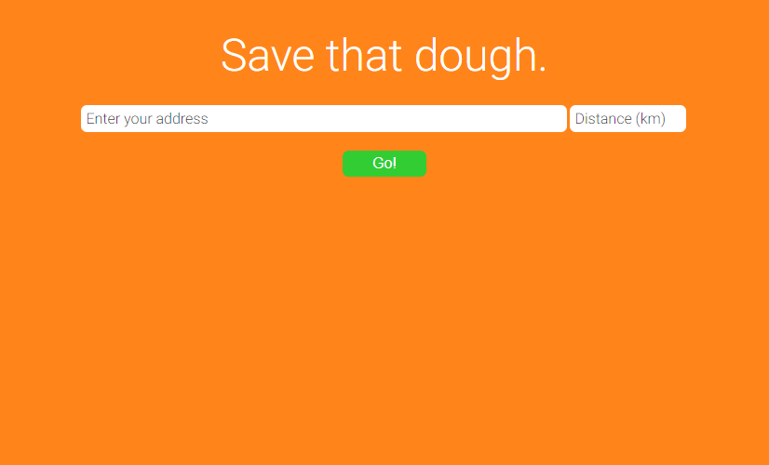
User-Interface

Slide 4
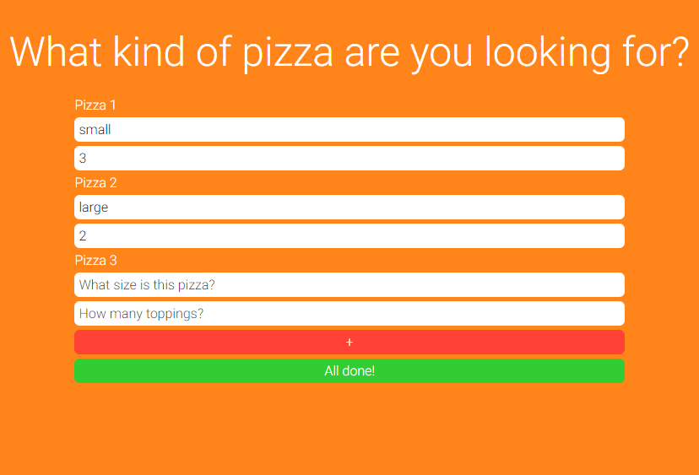
User-Interface

Slide 5
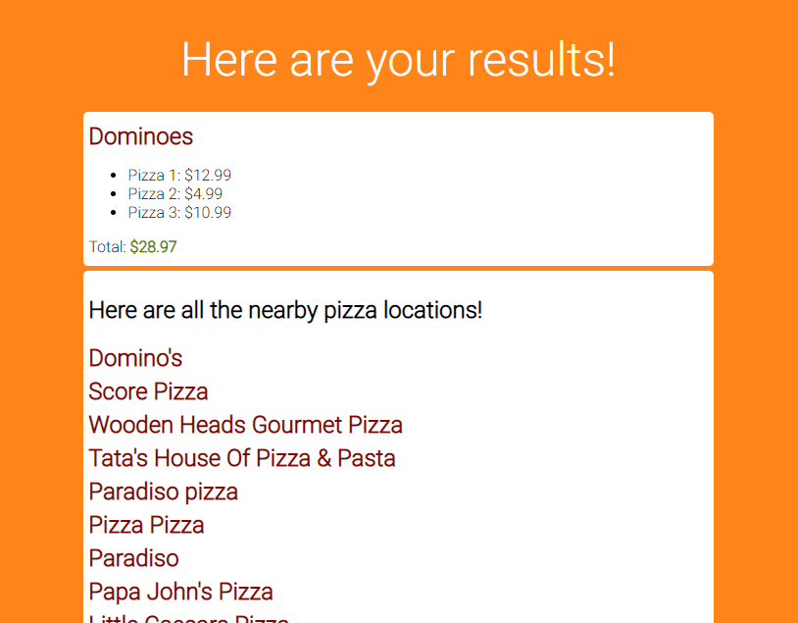
User-Interface

Slide 6

Google Maps API

Slide 7
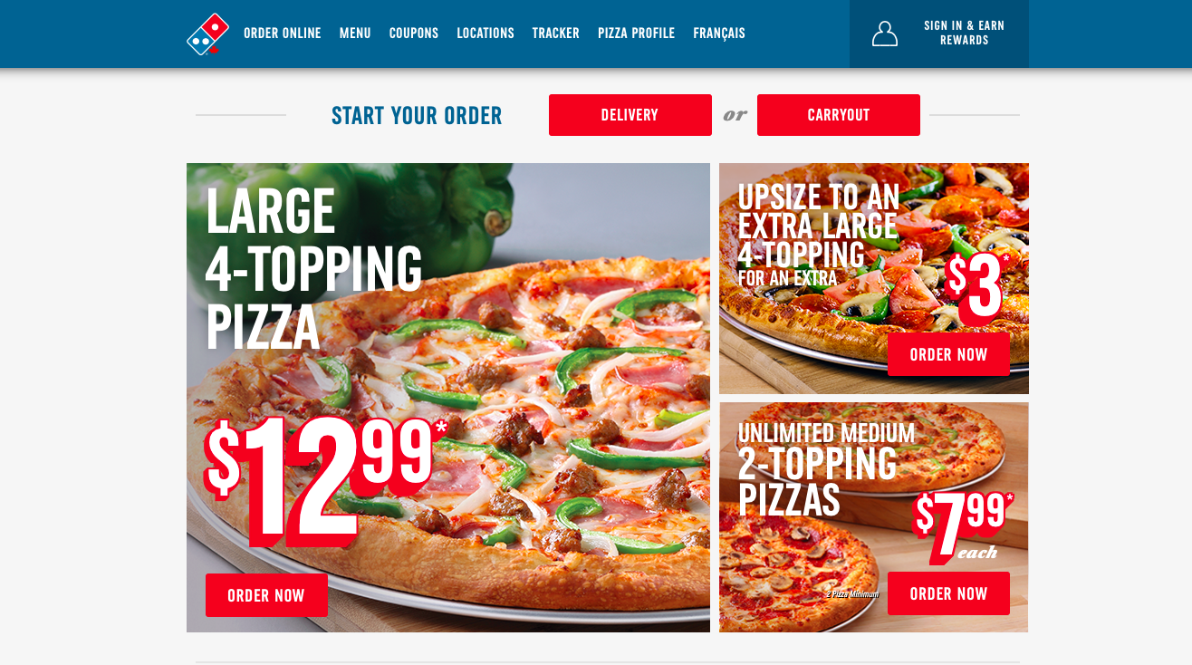
Web Scraping

